Slide 1

Research Data Management Platform
Health Informatics Centre

Slide 2
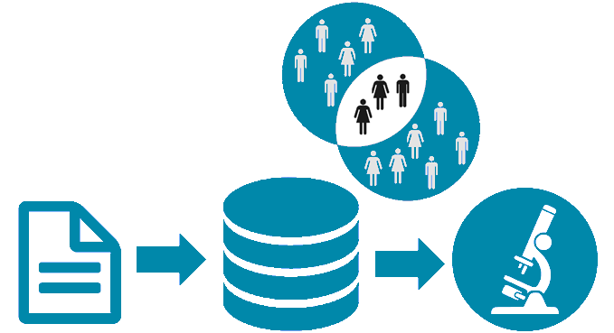

Slide 3
Electronic Health Record (EHR)
CHI | Sample Date | Test Code | Result | Lab Number | Units | ReadCode Value | ReadCode Description | Healthboard
0101010101 | 25/11/2012 21:35 | BI | 579.39 | BC64610 | umol/L |  |  | T
0101010101 | 09/04/2017 13:02 | UREA | 828.59 | CC503181 | mmol/L | 44J9. | UREA | F
0101010102 | 05/02/2000 09:25 | K | 217.90 | BC182027 |  | 44I4. | Serum potassium | F
0101010102 | 12/01/2001 06:24 | SODIUM | 172.99 | CC483728 |  | 44I5. | Sodium | T
Identifiers, -substitute for project specific Ids
Should we round to nearest Quarter?
What is BI?
What other codes exist for this test?
When does Fife data start?
Does project have governance for Fife data?

Slide 4
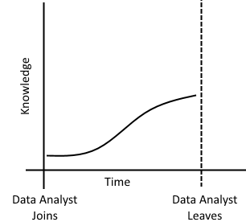
Data Analyst Lifecycle
Views
Descriptions in Excel / Word
Extraction Scripts
Project Cohorts
Cleaning Proceedures / Scripts
Lookup Tables
Data Load jobs e.g. SSIS
Data Quality Dashboards e.g QlickView

Slide 5
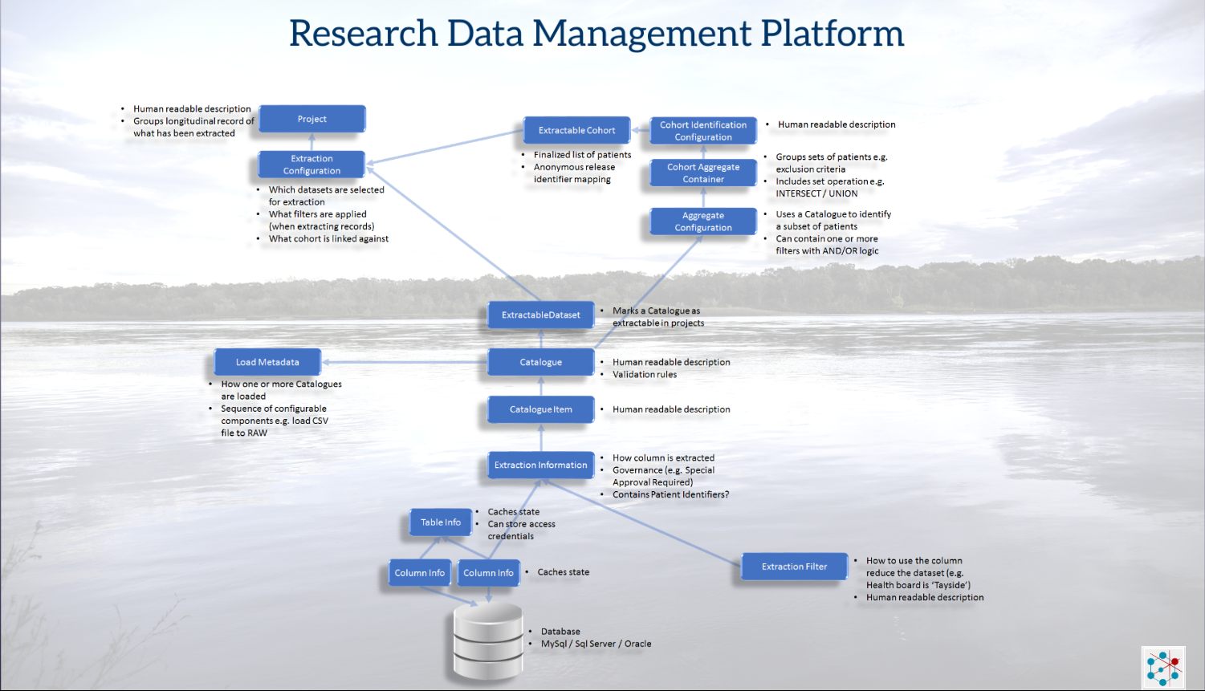
https://prezi.com/view/NMxTfqLnaNgrN3pnVizl/

Slide 6
Benefits of RDMP #1: Mean number of data releases per month
In past 5 years 1,321 data extracts for research have been produced with the largest extract linking data from 70 different datasets.
Tripled Productivity of Data Analysts producing data releases for researchers
*The research data management platform (RDMP): A novel, process driven, open-source tool for the management of longitudinal cohorts of clinical data
Nind T, et al. Gigascience. 2018 Jul 1;7(7). doi: 10.1093/gigascience/giy060

Slide 7
Benefits of RDMP #2: Reduction of error rates
*The research data management platform (RDMP): A novel, process driven, open-source tool for the management of longitudinal cohorts of clinical data
Nind T, et al. Gigascience. 2018 Jul 1;7(7). doi: 10.1093/gigascience/giy060

Slide 8
Benefits of RDMP #3: advantage for Research
Used for management of longitudinal research cohorts of datasets from multiple sources i.e. by research groups to manage their data
Use by other Safe Havens providing a similar service to HIC
Metadata, transforms and information capture
Audit, logging, data cleaning

Slide 9
RDMP Data Linkage Services Core Features
Data
Repository
Data Feeds
(e.g. SMR01, Vascular Lab)
RDMP Data Load & Curation
RDMP Cohort Builder
RDMP
Project Extraction Services
Anonymous
Extract
(Plus Metadata)
Cohort
Features
Audit
Release
Documents
Reproducibility
Validation
Drag and Drop
Summarisation
Governance
SQL Code Management
Extraction Policy Management

Slide 10
RDMP Data Linkage Services Core Features
Data
Repository
Data Feeds
(e.g. SMR01, Vascular Lab)
RDMP Data Load & Curation
RDMP Cohort Builder
RDMP
Project Extraction Services
Anonymous
Extract
(Plus Metadata)
Cohort
Features
Audit
Release
Documents
Reproducibility
Validation
Drag and Drop
Summarisation
Governance
SQL Code Management
Extraction Policy Management

Slide 11
RDMP Demo Break

Slide 12
RDMP Data Linkage Services Core Features
Data
Repository
Data Feeds
(e.g. SMR01, Vascular Lab)
RDMP Data Load & Curation
RDMP Cohort Builder
RDMP
Project Extraction Services
Anonymous
Extract
(Plus Metadata)
Cohort
Features
Audit
Release
Documents
Reproducibility
Validation
Drag and Drop
Summarisation
Governance
SQL Code Management
Extraction Policy Management

Slide 13
RDMP Demo Break

Slide 14
Advanced Cohort Example

Slide 15
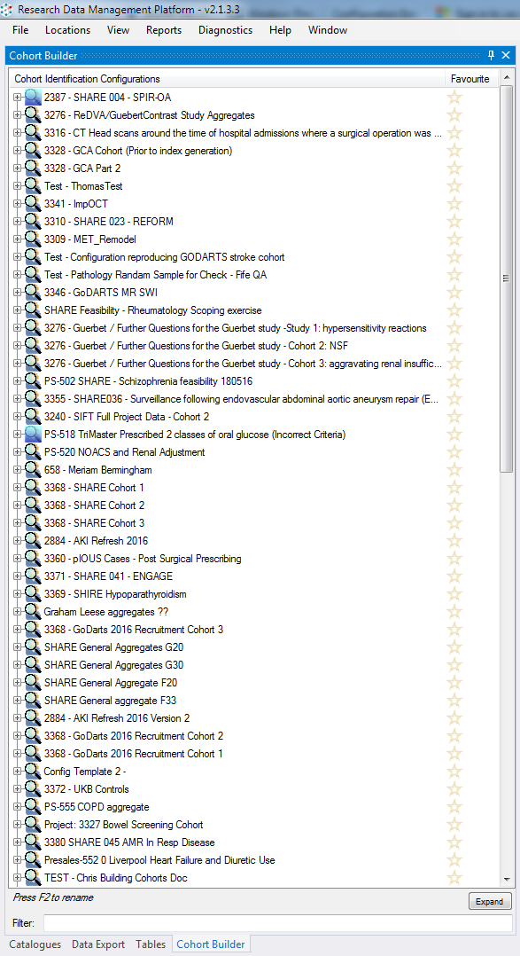
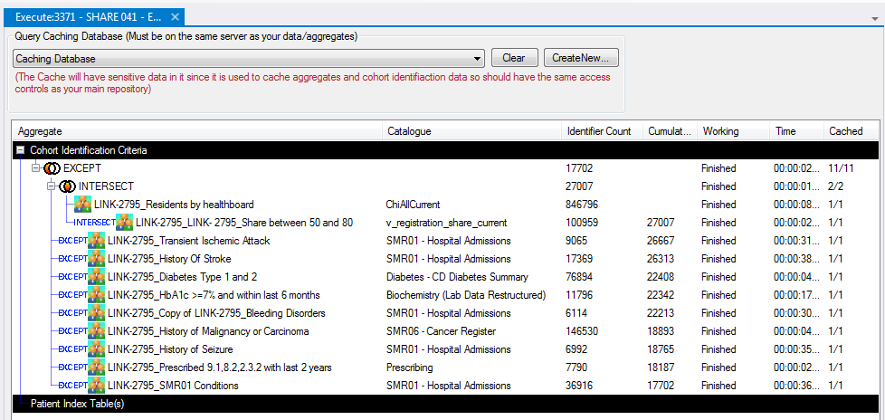

Slide 16
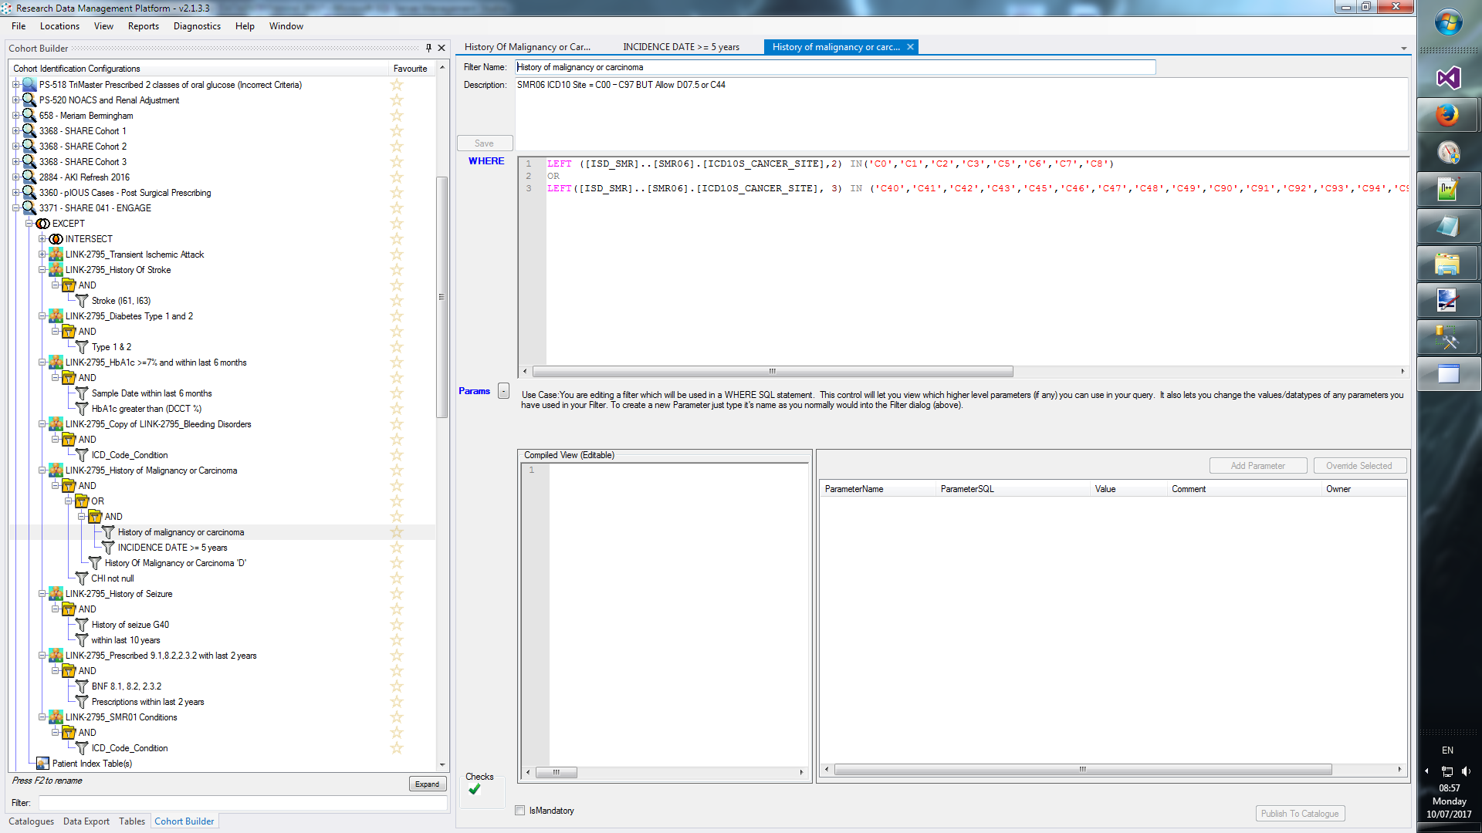

Slide 17
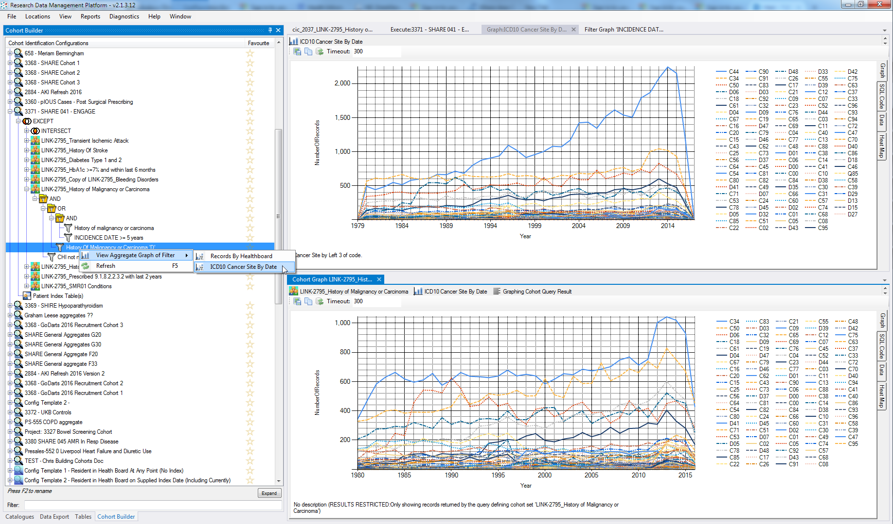

Slide 18
RDMP Data Linkage Services Core Features
Data
Repository
Data Feeds
(e.g. SMR01, Vascular Lab)
RDMP Data Load & Curation
RDMP Cohort Builder
RDMP
Project Extraction Services
Anonymous
Extract
(Plus Metadata)
Cohort
Features
Audit
Release
Documents
Reproducibility
Validation
Drag and Drop
Summarisation
Governance
SQL Code Management
Extraction Policy Management

Slide 19
RDMP Demo Break
Import File, Configure column extracts, anonymization, documentation

Slide 20
Data Set and Extraction Policy Management
Dataset Extraction Rules
Which columns are extracted
Which columns require special approval
Which columns are Never Extractable
Mandatory Filtering (only extract Tayside and Fife Healthboards)
Predefined filter templates
Anonymisation Rules (project specific):
Dilution ( DD1 ), Hashing (fe34ga7345) and Substitution ( T1010 -> A23299)
Dashboard Aggregates Graphs
Quality Metrics (e.g. CHI 100%, Condition Codes > 90%)
Important Meta data document attachments

Slide 21
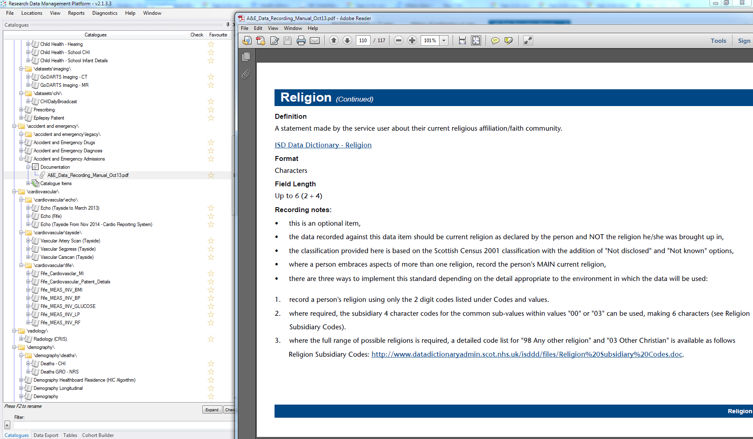

Slide 22
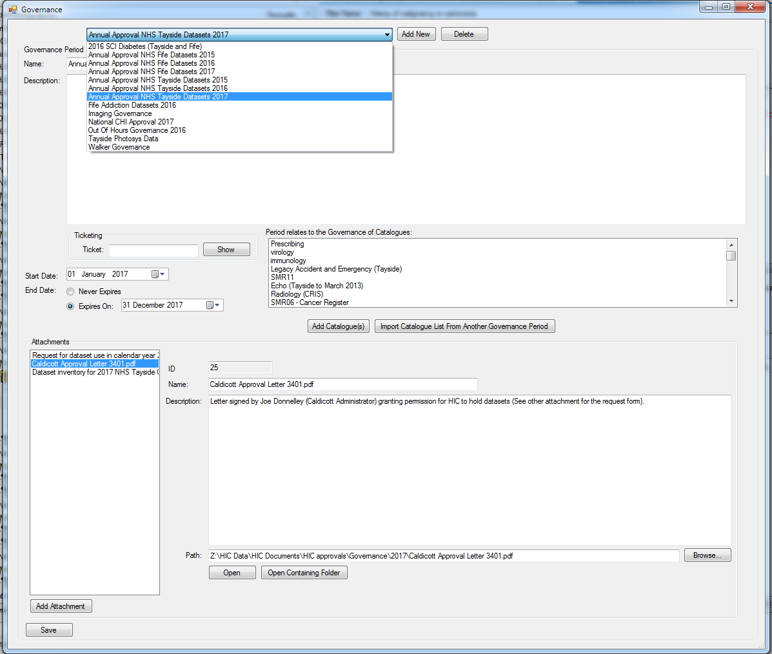

Slide 23
Audit
Every Extraction, Data Load, Data Quality Engine run etc
Extraction Queries
Number of records extracted / loaded etc
Who performed action
Extract location
MD5

Slide 24
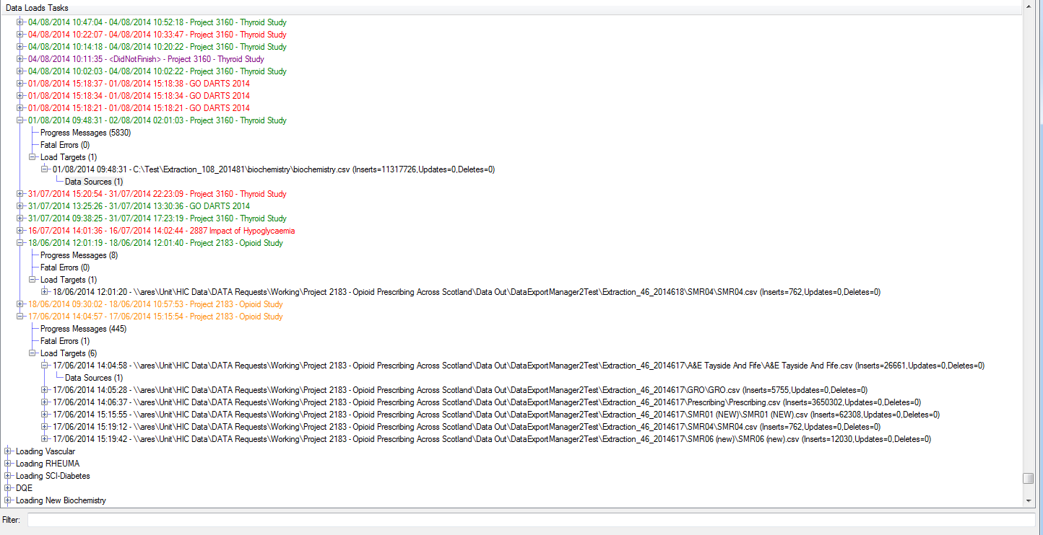

Slide 25
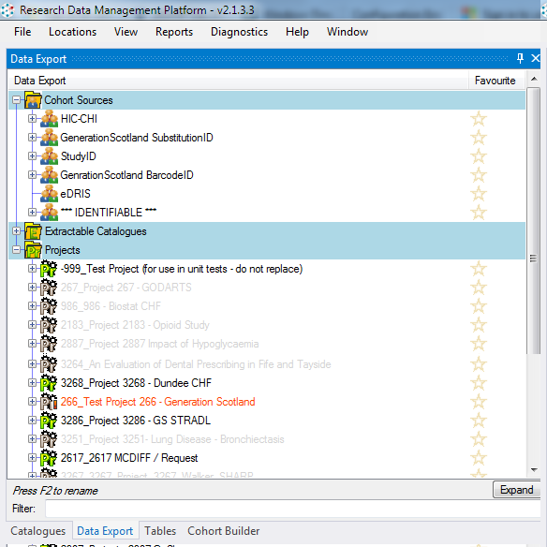
CHI => PROCHI
CHI => Generation Scotland ID
CHI => eDRIS Identifier
Released Projects
Projects with active extracts being built

Slide 26
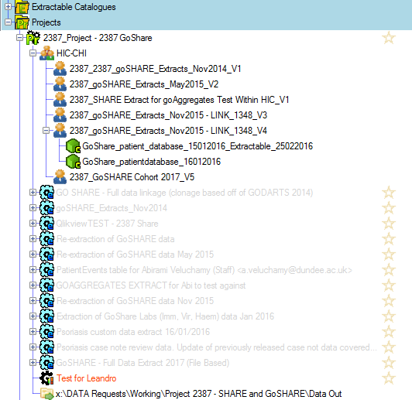
Within a Project:
Multiple cohort snapshots over time
Project/Cohort Specific Data Tables
Configurations (which datasets were extracted)
Were there any filters?

Slide 27
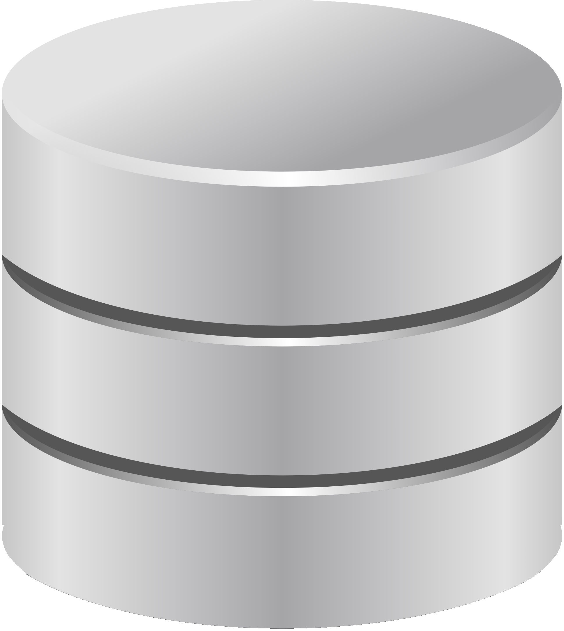
Human readable description
Groups longitudinal record of what has been extracted
Project
Extractable Cohort
Cohort Identification Configuration
Human readable description
Extraction Configuration
Finalized list of patients
Anonymous release identifier mapping
Groups sets of patients e.g. exclusion criteria
Includes set operation e.g. INTERSECT / UNION
Cohort Aggregate Container
Which datasets are selected for extraction
What filters are applied (when extracting records)
What cohort is linked against
Aggregate Configuration
Uses a Catalogue to identify a subset of patients
Can contain one or more filters with AND/OR logic
ExtractableDataset
Marks a Catalogue as extractable in projects
Load Metadata
Catalogue
Human readable description
Validation rules
How one or more Catalogues are loaded
Sequence of configurable components e.g. load CSV file to RAW
Catalogue Item
Human readable description
Extraction Information
How column is extracted
Governance (e.g. Special Approval Required)
Contains Patient Identifiers?
Table Info
Caches state
Can store access credentials
Extraction Filter
How to use the column reduce the dataset (e.g. Health board is ‘Tayside’)
Human readable description
Column Info
Column Info
Caches state
Database
MySql / Sql Server / Oracle

